Slide 1
Building end-to-end QA model with reward based objective
TEAM REINFORCE (Prashant and Eti)

Slide 2
Things completed
Char-level CNN(✔)
Removing irrelevant words from the vocabulary(✔)
Bi-Directional LSTM(✔)
Batching(✔)

Slide 3
This week’s Progress/Roadblocks
Batching
Masking
Masking and Padding to make sentences and queries of equal length
Calculating dual attention with respect to padded context and queries
Calculate loss based on normalized batch and mask it to remove losses corresponding to padded words
Sorting of sentences (to reduce variance in sentence lengths in a mini-batch)
Parallelization
Hyper-parameter tuning (very different for small/full dataset)

Slide 4
This week’s Progress/Roadblocks
Example:
A B C D <s> <s> 4
A <s> <s> <s> <s> <s> 1
A B C D E F 6
A B <s> <s> <s> <s> 2

Slide 5
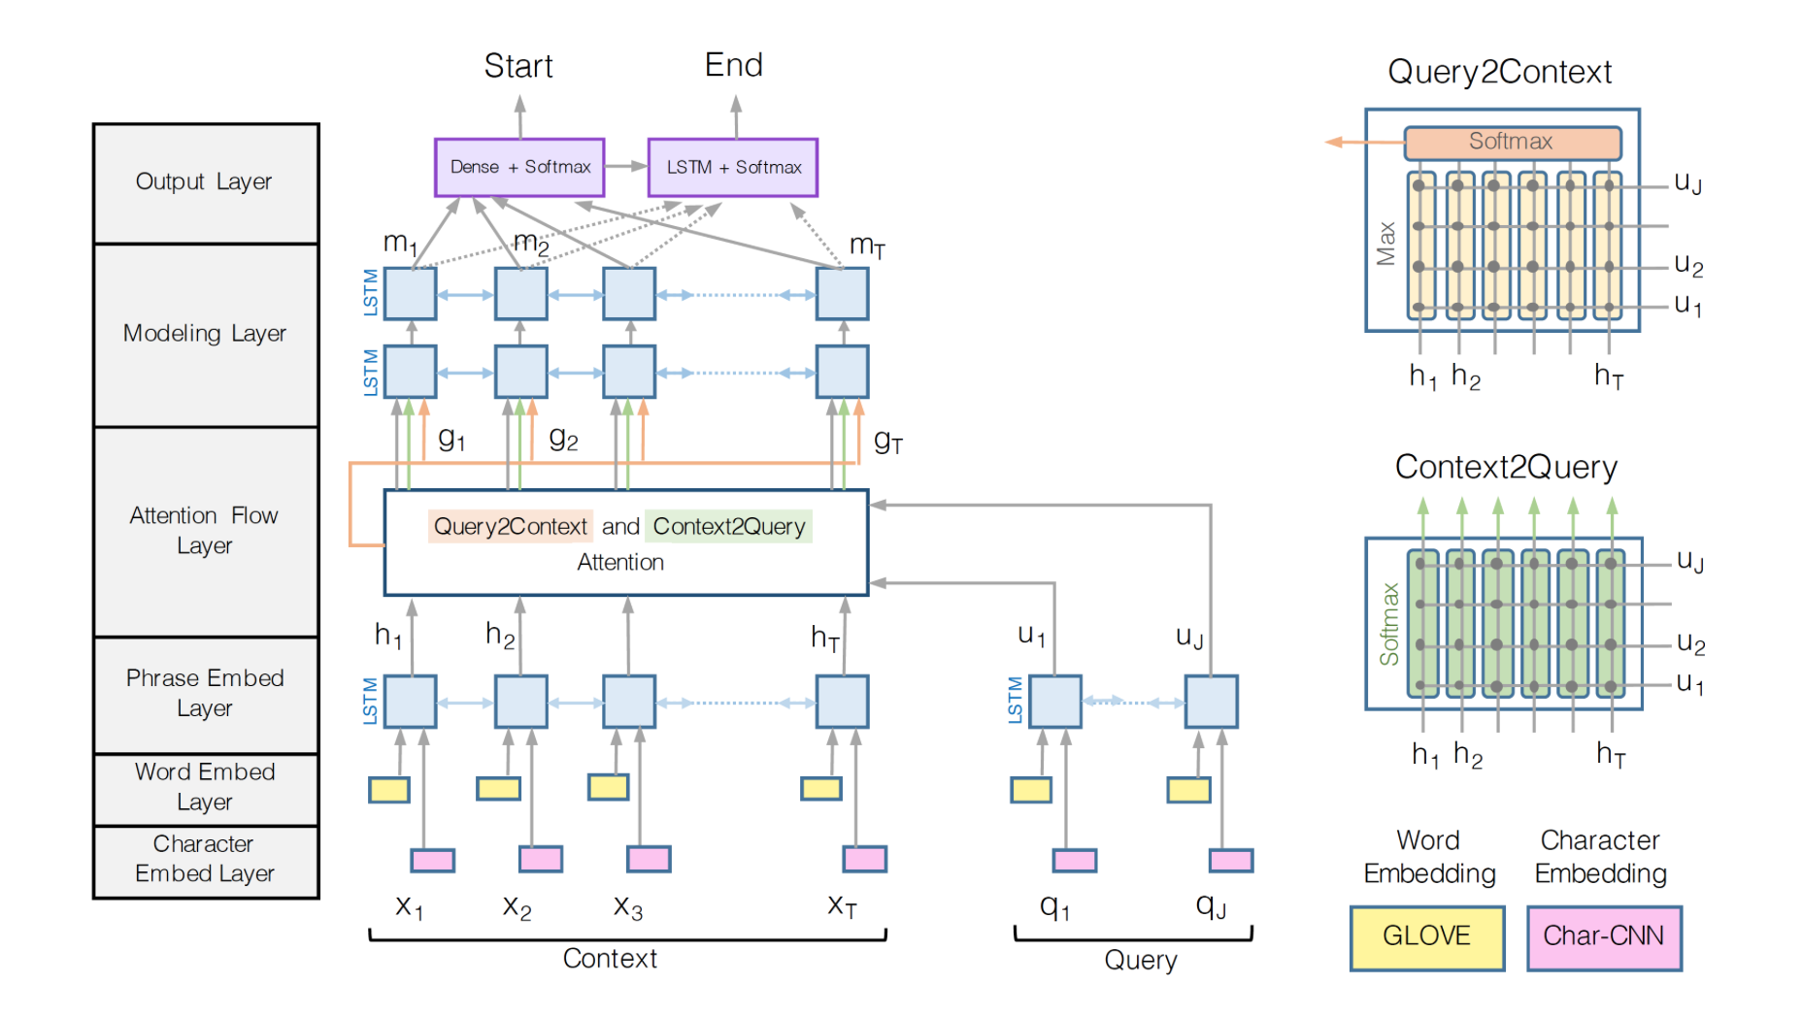
This week’s Progress/Roadblocks

Slide 6
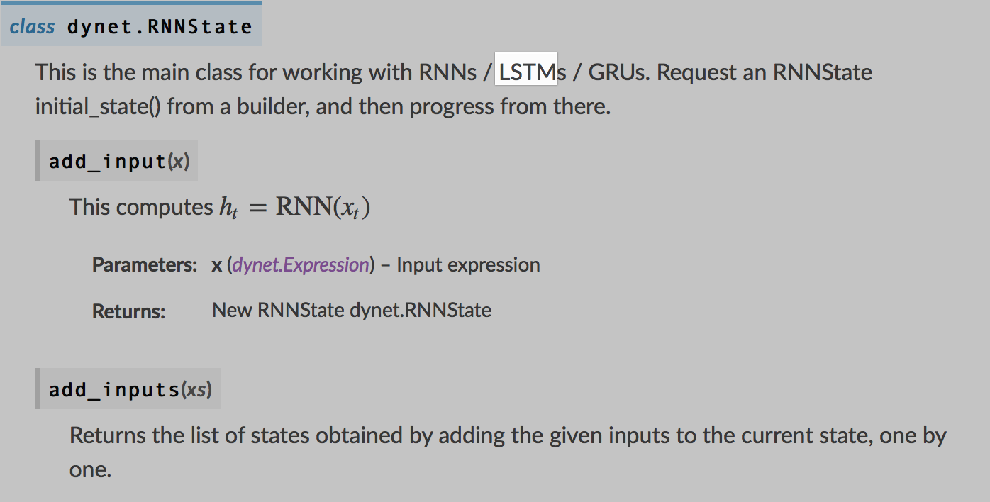
This week’s progress/Roadblocks
Write our own functions in dynet for Bi-directional LSTMs

Slide 7
Timeline
Date | Task
03/05 - 03/12 | Implementation and training of own BiDAF model in dynet(delayed 1 week)
03/13 - 03/30 | Running the model on Squad -- All the models are running right now, waiting for results -Testing ong SearchQA - Improving upon the existing baseline model
04/01 - 04/15 | Error Analysis and further improvement
Notes:
What to

